Slide 1
MINI PROJECT PRESENTATION
PRESENTED By --->
Name :- Danish Khan
Roll no :- 1814310071
Class :- CSE – 2
PRESENTED To --->
Prem Prakash
Lecturer of CSE Department
IMS ENGINEERING COLLEGE

Slide 2
PRESENTATION FLOW
PROBLEMS
INTRODUCTION
WORKING DIAGRAM
LANGUAGE USED
FEATURES
WORKING

Slide 3
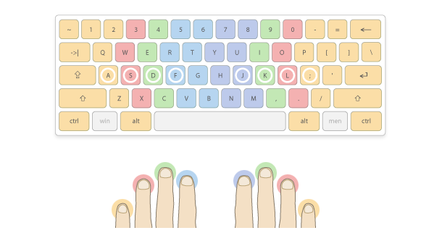
PROBLEM
Many times its happens that even a good student who is intelligent as well as knowledgeable do not have good typing speed which makes him less capable as compared to another student as a result student cannot produce the desired output in less time therefore there is a need for typing speed calculator which calculates the actual speed of the writer and makes his speed good as BIG Industry Level Employ have.

Slide 4
INTRODUCTION
The idea behind the project is to check the speed of the writer so that the writer can be able to check the speed of his typing and can improve it because in the industry level so you should have good typing speed as a result you can produce more output than others

Slide 5
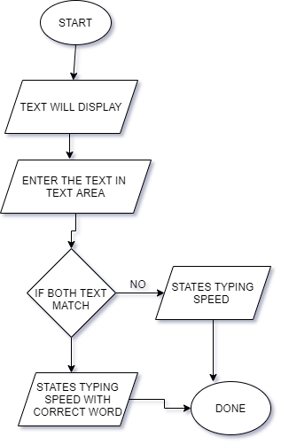
Working Diagram

Slide 6
Languages
USED
HTML
CSS
BOOTSTRAP
JAVASCRIPT

Slide 7
Features
It will display the time taken by the user to type
It will display the correct word out of total word that the user typed
It will display the total words that the user have typed
It will display the typing speed of the user

Slide 8
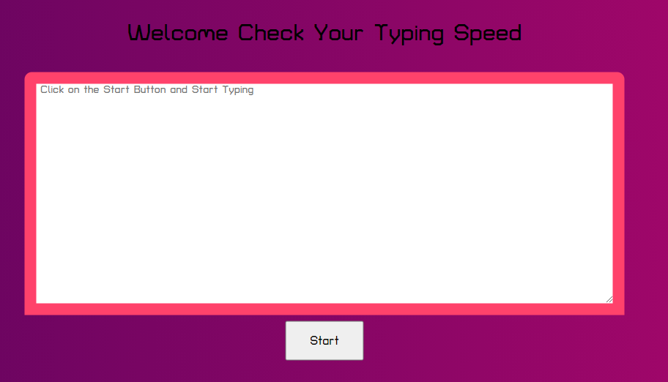
Step 1 :- Click on the Start Button
WORKING

Slide 9
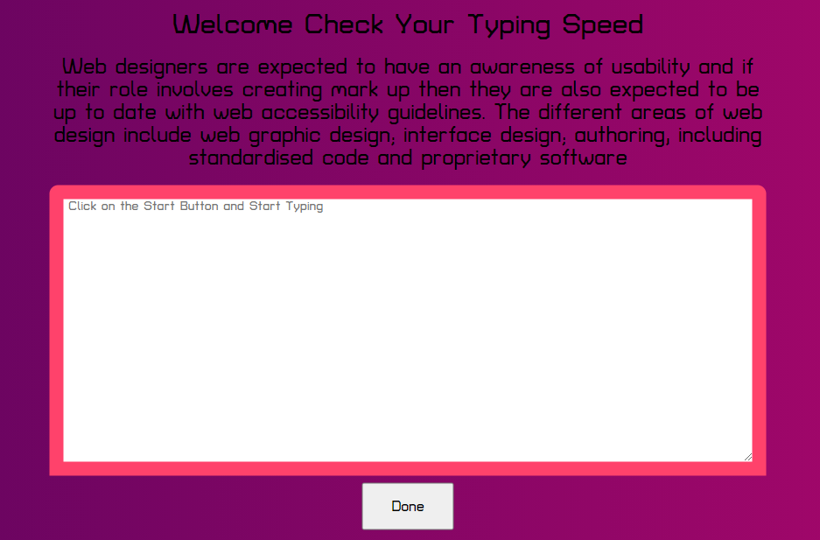
Step 2 :- Start typing the Text
WORKING

Slide 10
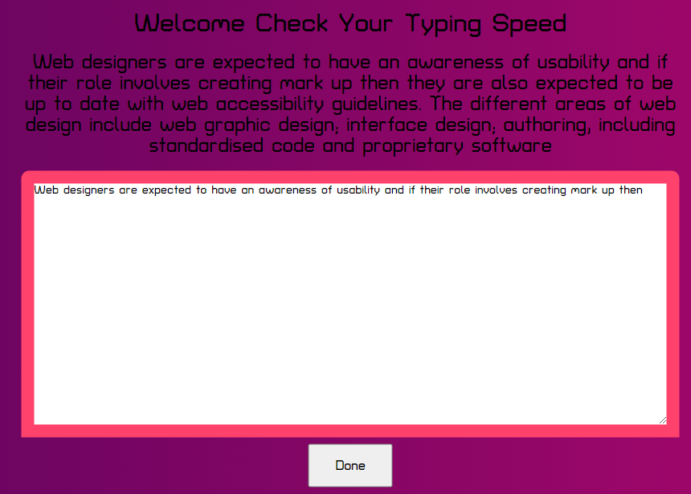
Step 3 :- After typing the text click on the Done Button
WORKING

Slide 11
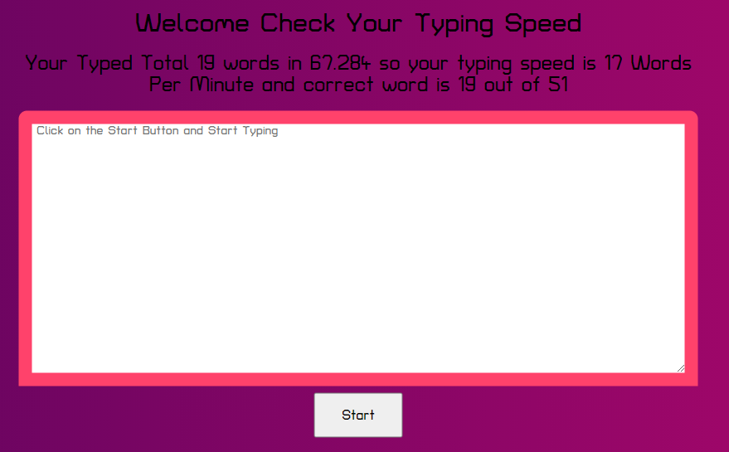
Step 4 :- User will get all the information regarding typing speed
WORKING

Slide 12
THANK YOU

